Slide 1

cv
Night Vision Imagery: Fusion of low-light visible and thermal IR images
Team Members
Nitin P Khatawate
Soumil Biswas
ShivPrasad Achari
Tanish V Sugnani
Under the Guidance of:
Dr. Shubha Bhat Mr. Sasidhar B
Associate Professor, Asst. Professor,
Dept. of CSE Dept. of CSE
Department of Computer Science & Engineering, DSCE

Slide 2
Contents
Introduction
Flowchart
Code Snippet
Functions Used
Input and Output images

Slide 3
cv
INTRODUCTION
In computer vision, Multisensor Image fusion is the process of combining relevant information from two or more images into a single image. The resulting image will be more informative than any of the input images.
Real-time implementation of the dual sensor fusion system combines imagery from either a low-light CCD camera or a short-wave infrared camera, with thermal long-wave infrared imagery.
Department of Computer Science & Engineering, DSCE

Slide 4
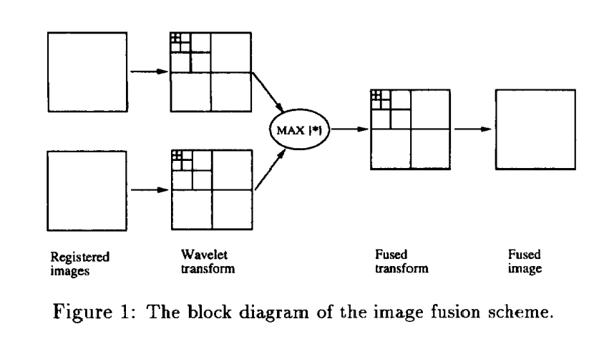
cv
FLOWCHART
Department of Computer Science & Engineering, DSCE

Slide 5
cv
CODE SNIPPET
A = 0.5*(A1+A2);
D = (abs(H1)-abs(H2))>=0;
H = D.*H1 + (~D).*H2;
D = (abs(V1)-abs(V2))>=0;
V = D.*V1 + (~D).*V2;
D = (abs(D1)-abs(D2))>=0;
D = D.*D1 + (~D).*D2;
Department of Computer Science & Engineering, DSCE

Slide 6
cv
FUNCTIONS USED
imread:-
Read image from graphics file
ex:A = imread(filename)
Imshow(I):-
Displays image I in a figure
subplot:-
Create axes in tiled positions
ex: subplot(m,n,p)
swt2:-
Discrete stationary wavelet transform 2-D
ex:SWC = swt2(X,N,'wname') or [A,H,V,D] = swt2(X,N,'wname')
compute the stationary wavelet decomposition of the matrix X at level N, using . 'wname'.
Department of Computer Science & Engineering, DSCE

Slide 7
cv
FUNCTIONS USED
iswt2:-Inverse discrete stationary wavelet transform 2-D.
ex: X = iswt2(SWC,'wname') or X = iswt2(A,H,V,D,wname)
abs:-Absolute value and complex magnitude
Department of Computer Science & Engineering, DSCE

Slide 8
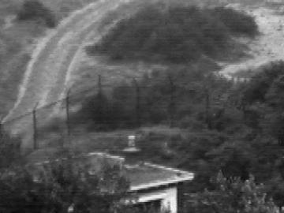
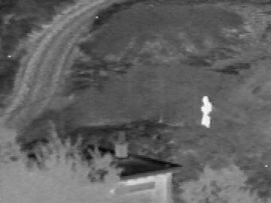
INPUT IMAGES
Visible Image
IR Image

Slide 9
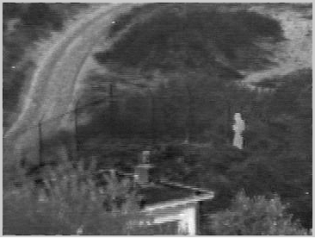
cv
Output
Department of Computer Science & Engineering, DSCE

Slide 10
cv
THANK YOU
Department of Computer Science & Engineering, DSCE

